Slide 1
Understanding Chemical Reactions
Lesson: Bonds & Energy

Slide 2
Basic Revision
For a chemical reaction to occur, bonds must be both formed and broken
Fe + CuSO₄ Cu + FeSO₄

Slide 3
Basic Revision
Chemical reactions always involve energy changes.
Making and breaking bonds involves energy changes

Slide 4
ENERGY AND CHEMICAL REACTIONS
Exothermic reactions
These reactions give out heat energy.
Combustion is an exothermic reaction.

Slide 5
ENERGY AND CHEMICAL REACTIONS
Endothermic reactions
These reactions take in heat energy from their surroundings.
These cause temperatures to fall.

Slide 6
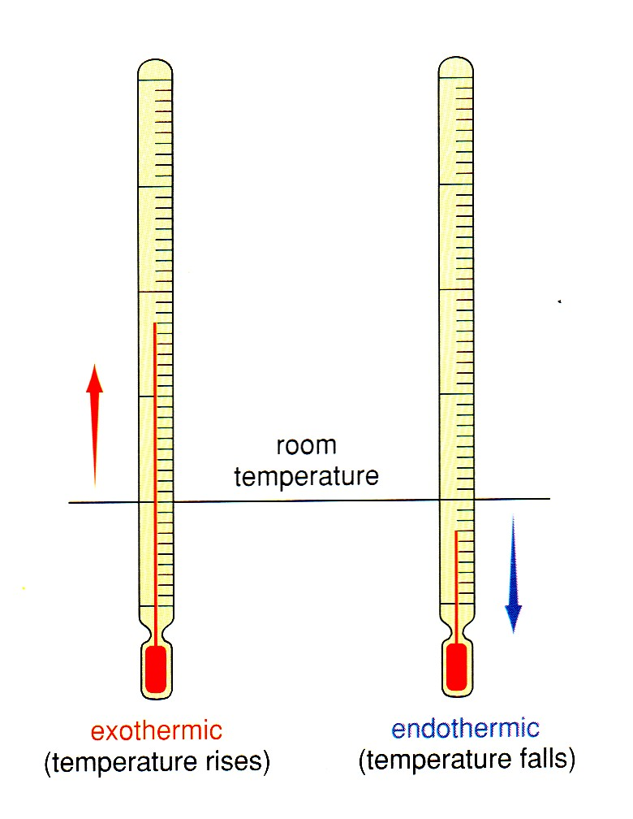

Slide 7
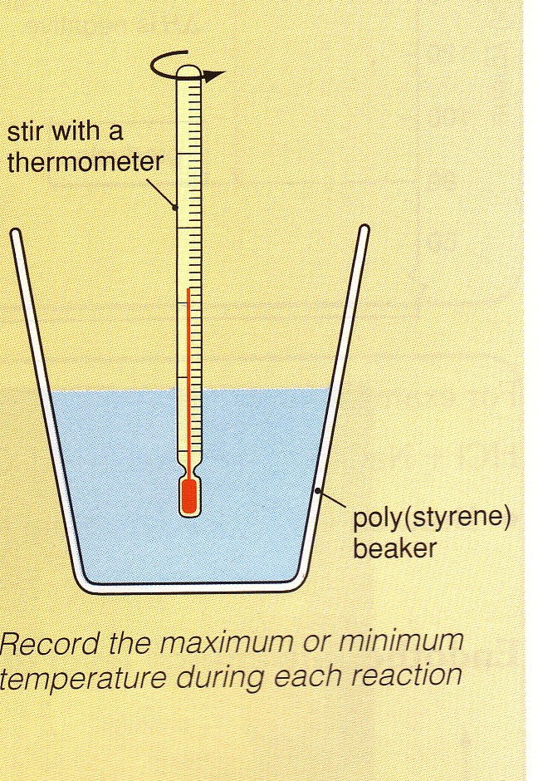
ENERGY AND CHEMICAL REACTIONS
Use the apparatus as shown.
Work with 20ml of each substance in turn.
Copy the results table before you start

Slide 8
RISK ASSESSMENT
You will be using acids so wear safety goggles.
Wipe up spills immediately
Replace stoppers
Do not put solids down the sink – use the bowl at the front!

Slide 9
ENERGY AND CHEMICAL REACTIONS
Reaction | temp. before mixing (⁰C) | temp. after mixing (⁰C) | Exothermic or Endothermic?
sodium hydroxide sol’n + hydrochloric acid
sodium hydrogen carbonate sol’n + citric acid
copper sulphate sol’n + magnesium powder
sulphuric acid + magnesium ribbon
barium chloride + sodium sulphate

Slide 10
ENERGY LEVEL DIAGRAMS
We can show the energy transfers in reactions on an energy level diagram.
These show us the energy stored in the reactants compared to the energy stored in the products.

Slide 11
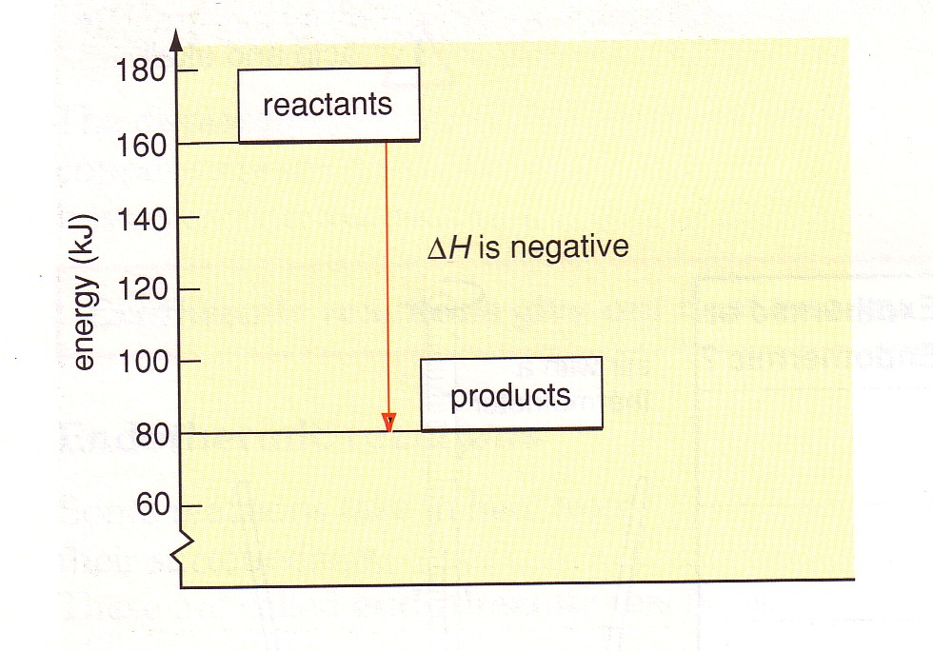
Exothermic energy level diagram

Slide 12
Exothermic energy level diagram
∆H (‘delta H’) is the symbol for the ‘change in energy’.
In an exothermic reaction the products have less energy than the reactants.
∆H is negative for an exothermic reaction.

Slide 13
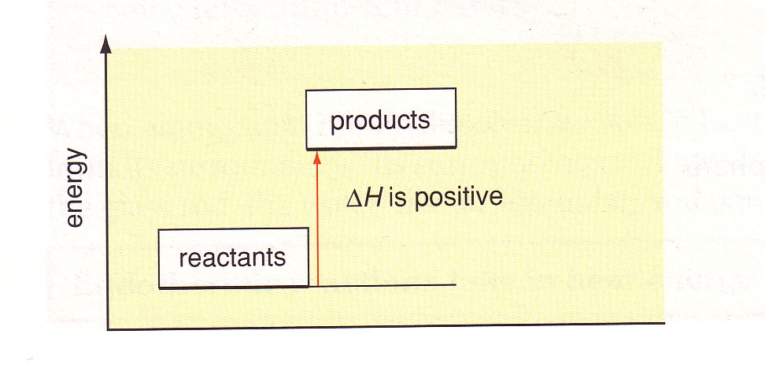
Endothermic energy level diagram

Slide 14
Endoothermic energy level diagram
In an endothermic reaction the products have more energy than the reactants.
∆H is positive for an endothermic reaction.

Slide 15
Making and breaking bonds
We have seen how bonds are formed (both ionic and covalent)
Do you think energy is needed to break bonds?

Slide 16
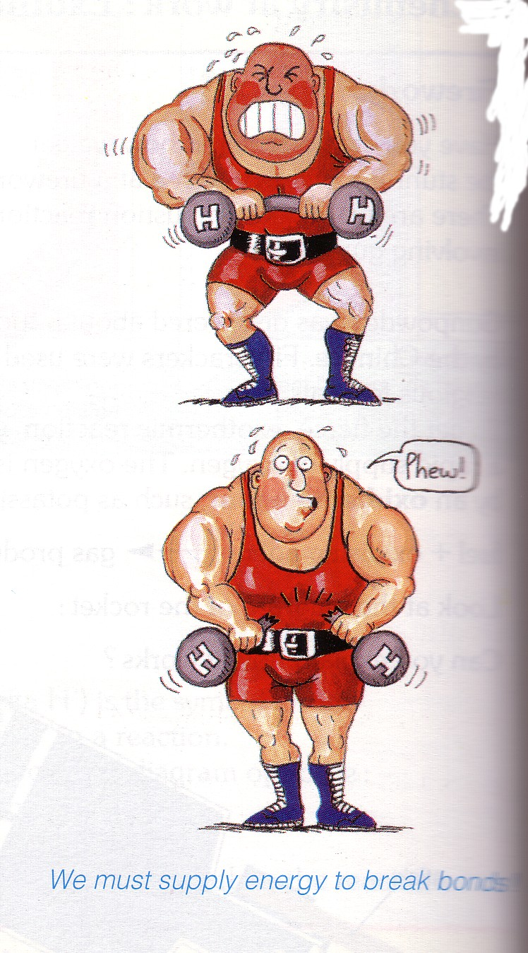

Slide 17
Breaking bonds requires energy. It is endothermic.

Slide 18
Breaking bonds requires energy. It is endothermic.
Making new bonds gives out energy. It is exothermic.

Slide 19
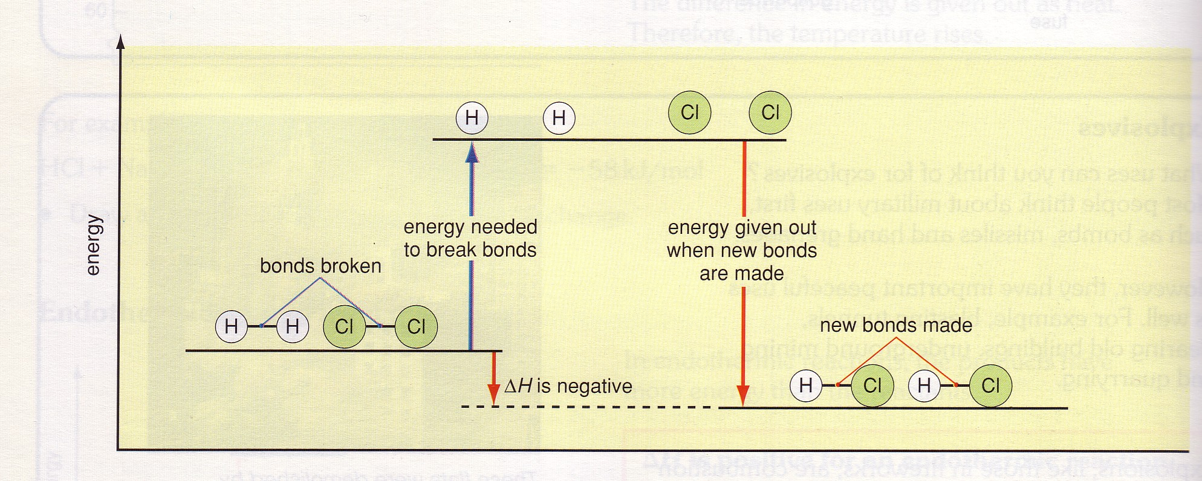

Slide 20
This powerpoint was kindly donated to www.worldofteaching.com
http://www.worldofteaching.com is home to over a thousand powerpoints submitted by teachers. This is a completely free site and requires no registration. Please visit and I hope it will help in your teaching.

